Slide 1
JAVA SEMINAR
10. Design and implement a JAVA JSP Program to get student information through a HTML and create a JAVA Bean Class, populate Bean and display the same information through another JSP.

Slide 2
STEPS:
Install “APACHE TOMCAT” application server zip file and extract it.
In eclipse IDE(ENTERPRISE EDITION) Add the tomcat server and start the server.
In web browser, localhost:8080 tomcat server get started.
In eclipse IDE ,one JAVA file and two JSP file has to be created.

Slide 3
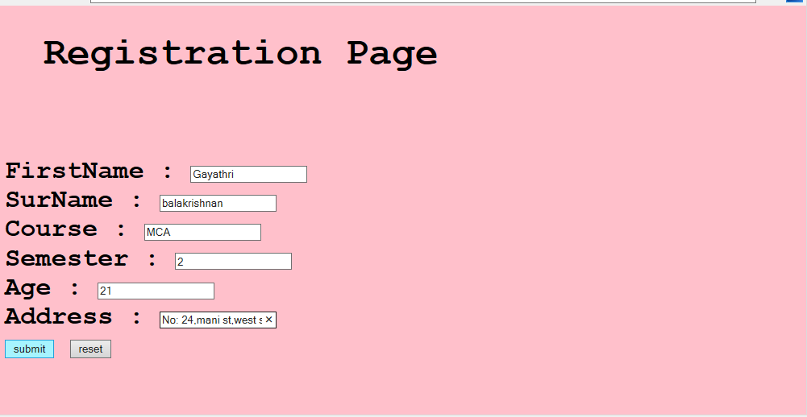
OUTPUT:
The above displayed form gets displayed when the program gets run

Slide 4
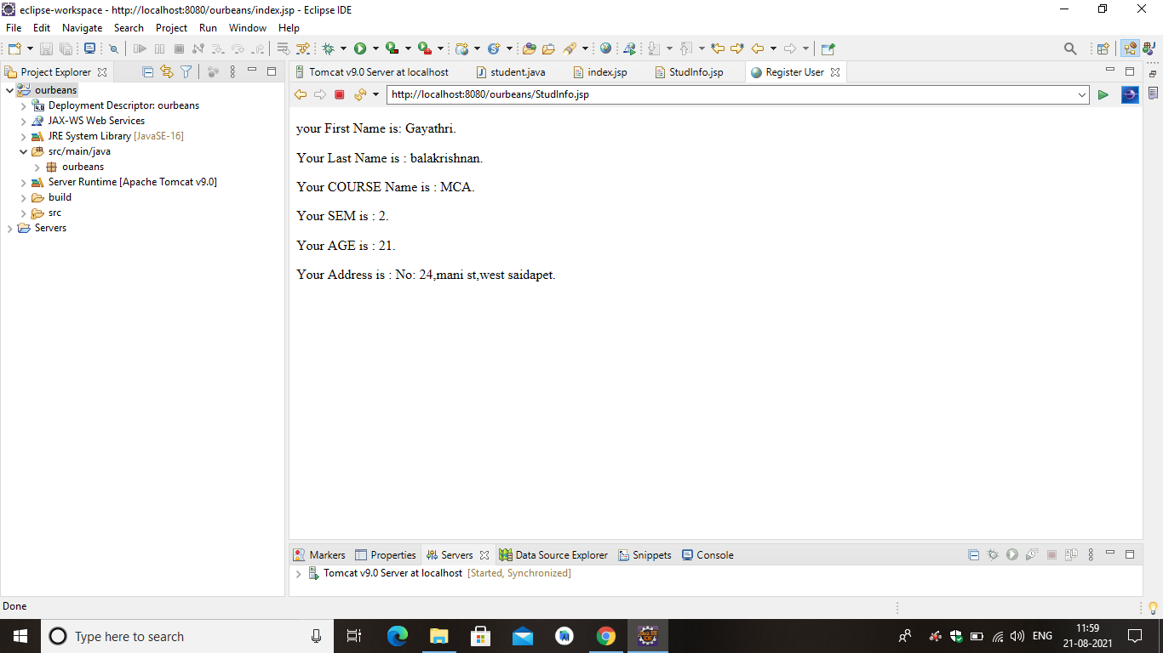
Output:
When submit button is clicked the form gets displayed through another jsp

